Slide 1

Cisco AppDynamics RTX Roadshow
Mark Kurpiel – Custom Success Specialist

Slide 2
Agenda
Overview of Cisco AppDynamics
AppDynamics @ Pratt @ Whitney
Benefits of AppD @ Pratt @ Whitney
Next Steps

Slide 3









The Modern Digital Services Problem
SaaS
CLOUD PROVIDERS
SaaS
SERVICE PROVIDERS
COLOCATION
SaaS
SaaS
SaaS
CAMPUS
BRANCH
DATA CENTER
EDGE | IOT & OT

Slide 4
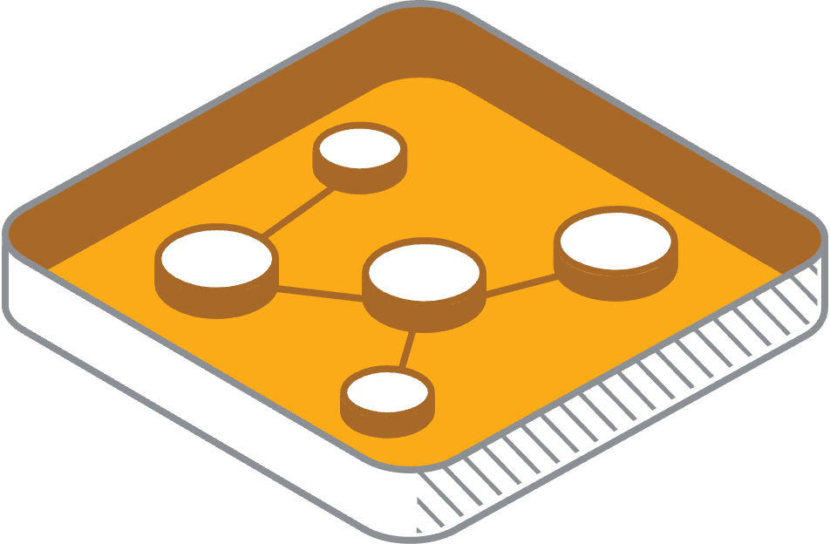
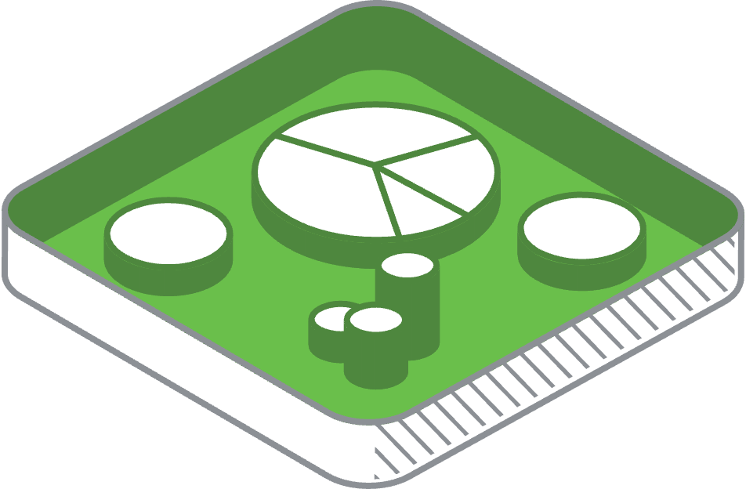

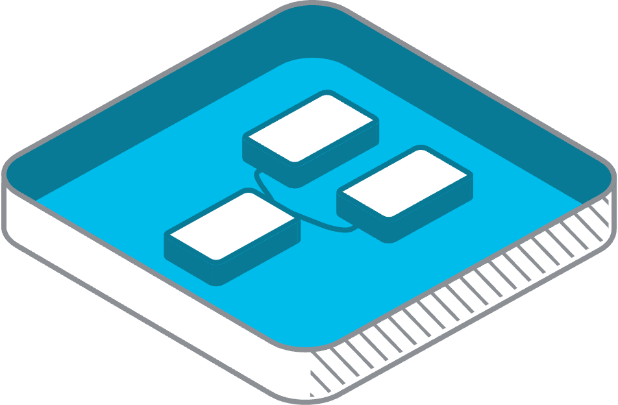
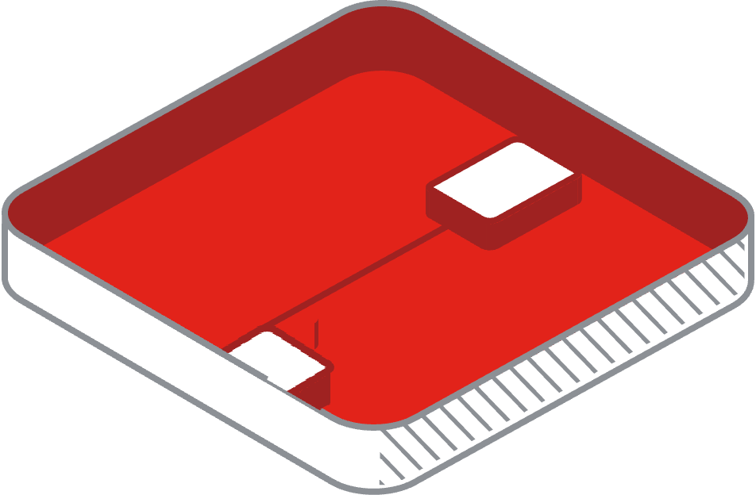

The Modern Digital Services Problem
APPLICATION
NETWORK
SaaS
CLOUD PROVIDERS
SaaS
BUSINESS
SERVICE PROVIDERS
COLOCATION
USER EXPERIENCE
SaaS
SaaS
SaaS
SECURITY
CAMPUS
BRANCH
DATA CENTER
EDGE | IOT & OT
INFRASTRUCTURE

Slide 5
Full-Stack Visibility
SaaS
BUSINESS
USER EXPERIENCE
CLOUD PROVIDERS
SaaS
SERVICE PROVIDERS
APPLICATION
COLOCATION
SaaS
INFRASTRUCTURE
SaaS
SaaS
NETWORK
CAMPUS
BRANCH
DATA CENTER
EDGE | IOT & OT
SECURITY

Slide 6

Full–Stack Observability
with Business context
Prioritize issues with Business Context
Full-Stack
Visibility
Full-Stack Insights
Application Business & Experiences
Full-Stack Actions
Remediations & Optimizations
Log in supplier portal
Revenue
Delivery information
App API Call
Remediations
Conversion
Capacity information
3rd Party SaaS service
Delivery Service
Routing Optimization
Delivery confirmation
User journey
Accounts Payable report
Cloud Instance
Scale Down
Full-Stack actions for the business

Slide 7
Full–Stack Observability
with Business context
Prioritize issues with Business Context
Full-Stack
Visibility
Full-Stack Insights
Application Business & Experiences
Full-Stack Actions
Remediations & Optimizations
Log in supplier portal
Revenue
Delivery information
App API Call
Remediations
Conversion
Capacity information
3rd Party SaaS service
Delivery Service
Routing Optimization
Delivery confirmation
User journey
Accounts Payable report
Cloud Instance
Scale Down
Full-Stack actions for the business

Slide 8






AppDynamics Product Architecture
Secure Application
SaaS/On-Prem Controller
User Interface & Reporting
Correlated transaction view
No code changes required
<Low overhead in production
One-Way HTTP/S
One-Way HTTP/S
One-Way HTTP/S
One-Way HTTP/S
Remote JDBC
One-Way HTTP/S
API/Product Exp.
End User Agent
ThousandEyes
Application Agent
Server Agent
Database
Network
Expanding Capabilities
Browser / Mobile / IoT
Network / Device / Digital Experience (Bidirectional Integration)
Java .NET. PHP Node.js C++ Python Go Extensions
SAP
OS, Cloud-Native (CloudWatch, AppInsights, X-ray)
SQL / noSQL / Cloud (Aurora)
ACI, CWOM, Harness, DCI
SecureApplication (Included with App agent)

Slide 9
Cisco AppDynamics + Pratt & Whitney

Slide 10
Cisco AppDynamics @ Pratt & Whitney
Deployed across Quality and production environment across Pratt & Whitney US and Canada
Monitoring business critical application with Pratt & Whitney such as
Solumina
Team Center
Tidal
Kepware
Autoair
Monitoring across Application, infrastructure, Database, network and End user monitoring
Some of primary use-cases are –
Slow Transaction detection
Slow responses on several critical queries
Proactively notification to the teams.
Trace level information and debugging information

Slide 11
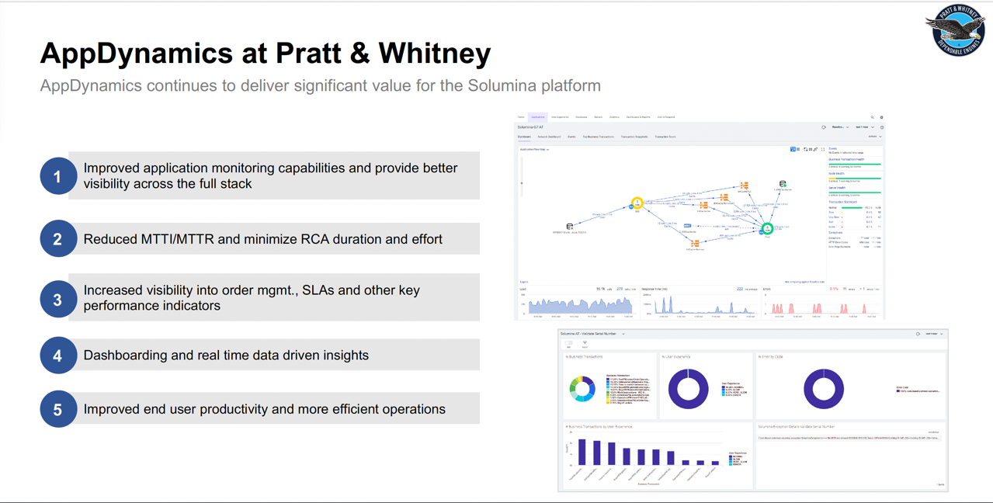

Slide 12
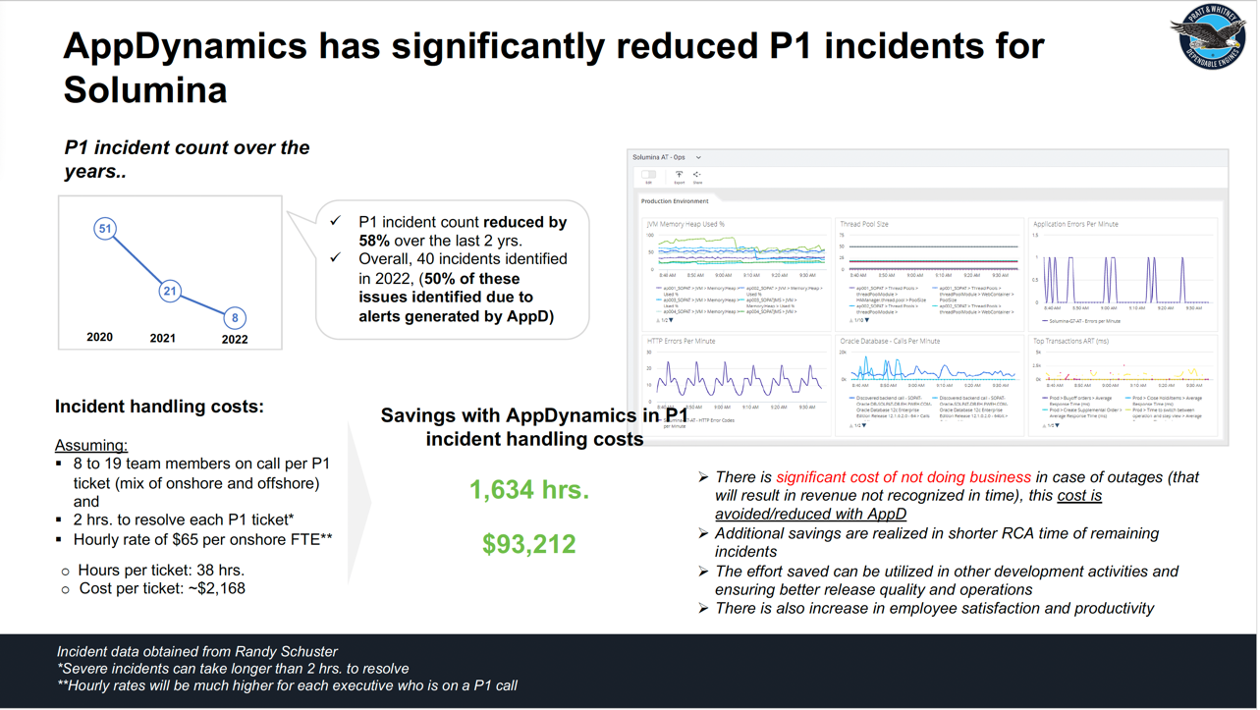

Slide 13
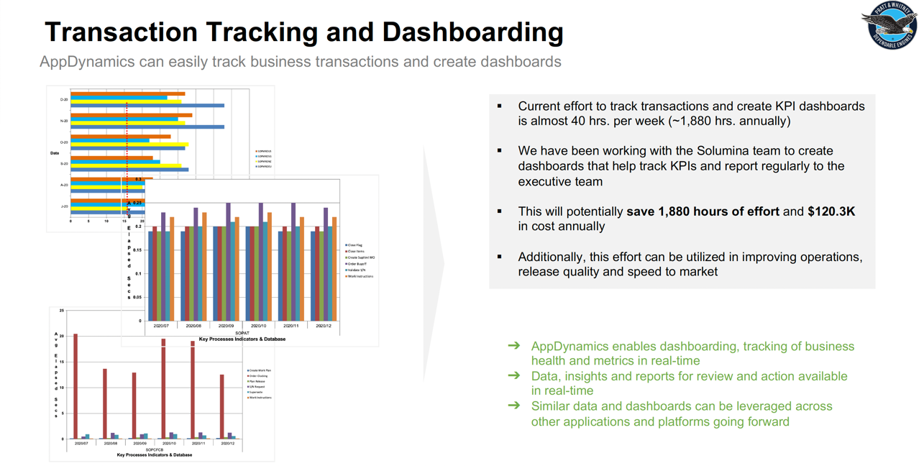

Slide 14
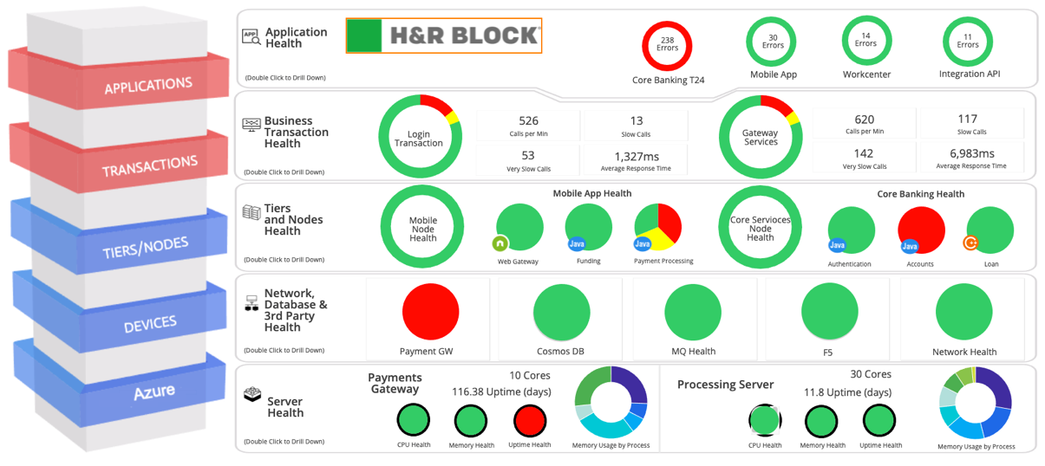
Sample Dashboard
Postal Services
Art of Possible Application and Infrastructure Dashboard:
Dashboard can represent any Application’s Environment
Top to Bottom Application Infrastructure View
Customize based upon customer requirements

Slide 15
Next Steps
Discuss use-cases and challenges for RTX
Understand RTX environment
Custom Demo of Cisco – AppD solution

Slide 16
Future State capabilities
App dashboard representing Specific KPI’s of the application
Real-time business transparency with integrated analytics
Provides insight into performance to manage daily business SLA’s

Slide 18
Thank You

